Slide 1
Project 9: EKF-based Localisation with LRF
Presentation 5:
Results
Notes:
Hello, this is our final presentation on project number 9: EKF-based localisation with a LRF

Slide 2
Outline
Results
Prediction
Matching
Update
To Do List
Project Review
Questions
Notes:
In comparison to the last weeks we have a lot of progress and results to show, that‘s why I wont explain the outline of this presentation. Let’s just dive into the results and see what we were able to do.

Slide 3
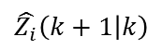
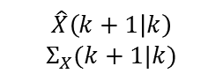
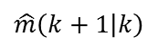
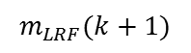
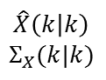
EKF Implementation
Update
Matching
$$\hat{X}\left(k | k\right)$$
$$Σ_{X}(k|k)$$
$$\hat{Z_{i}}\left(k+1 | k\right)$$
Prediction
Motion model
Observation model
$$\hat{X}\left(k+1 | k\right)$$
$$Σ_{X}(k+1|k)$$
$$\hat{m}\left(k+1 | k\right)$$
Ray casting
ICP
$$m_{LRF}(k+1)$$
Odometry
Map
LRF
Notes:
Yet to be written

Slide 4
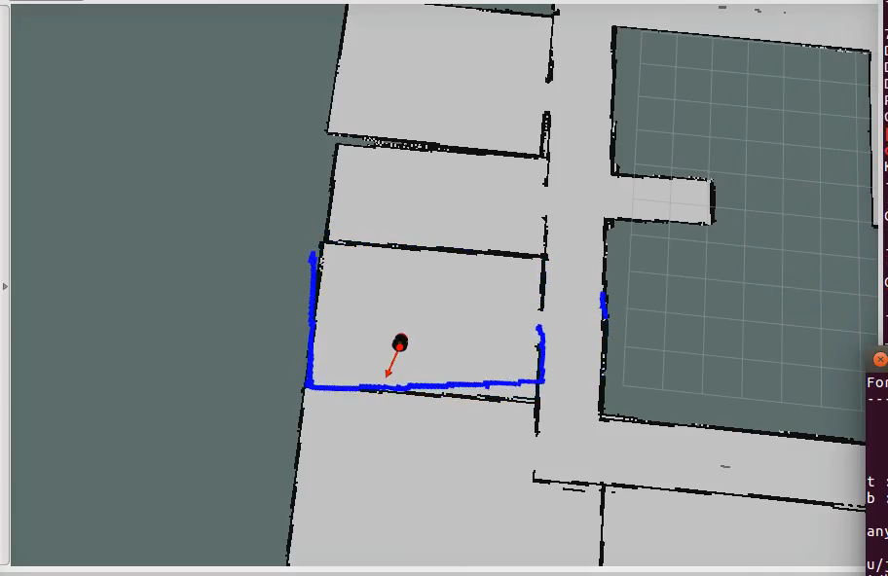
Results
Notes:
Yet to be written

Slide 5
EKF Implementation
Update
Matching
$$\hat{X}\left(k | k\right)$$
$$Σ_{X}(k|k)$$
$$\hat{Z_{i}}\left(k+1 | k\right)$$
Prediction
Motion model
Observation model
$$\hat{X}\left(k+1 | k\right)$$
$$Σ_{X}(k+1|k)$$
$$\hat{m}\left(k+1 | k\right)$$
Ray casting
ICP
$$m_{LRF}(k+1)$$
Odometry
Map
LRF
Notes:
Yet to be written

Slide 6
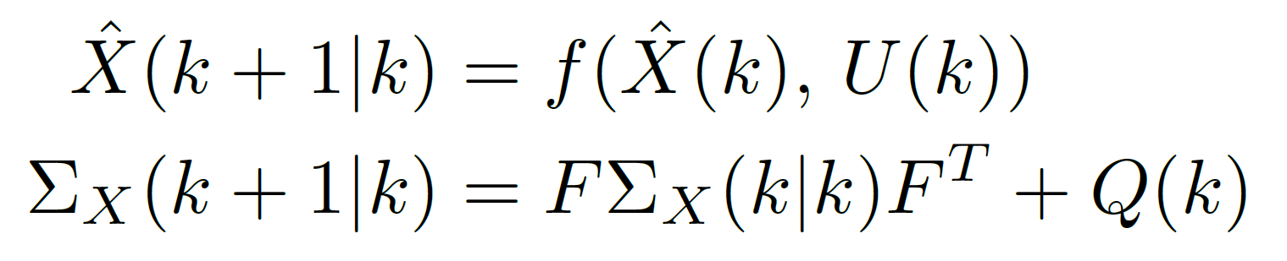
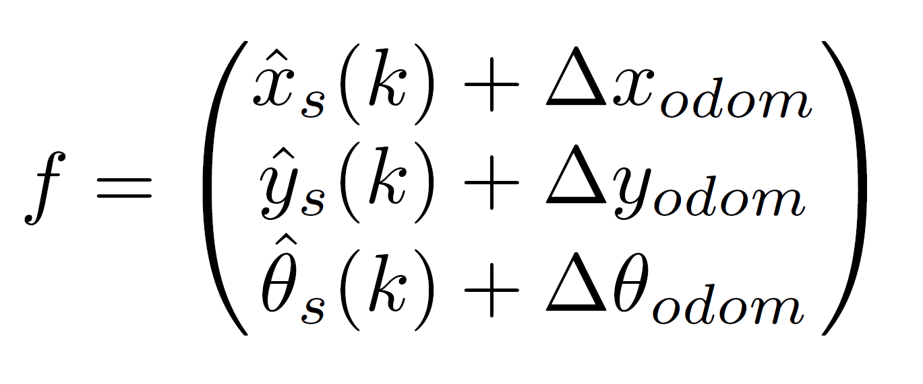
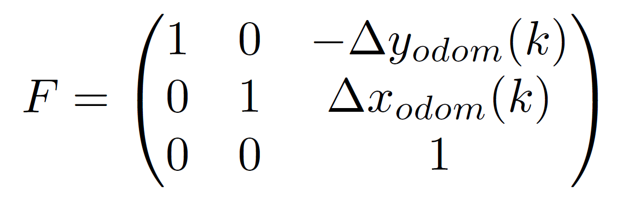
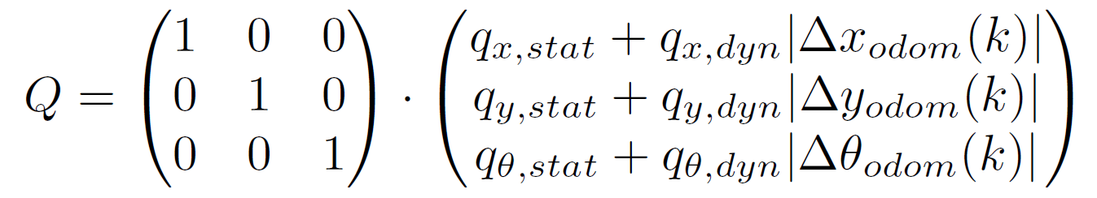
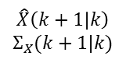
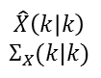
Motion Model
$$\hat{X}\left(k | k\right)$$
$$Σ_{X}(k|k)$$
Motion model
$$\hat{X}\left(k+1 | k\right)$$
$$Σ_{X}(k+1|k)$$
Odometry
Notes:
Yet to be written

Slide 7
EKF Implementation
Update
Matching
$$\hat{X}\left(k | k\right)$$
$$Σ_{X}(k|k)$$
$$\hat{Z_{i}}\left(k+1 | k\right)$$
Prediction
Motion model
Observation model
$$\hat{X}\left(k+1 | k\right)$$
$$Σ_{X}(k+1|k)$$
$$\hat{m}\left(k+1 | k\right)$$
Ray casting
ICP
$$m_{LRF}(k+1)$$
Odometry
Map
LRF
Notes:
Yet to be written

Slide 8
Observation Model
Important:
Only compare points that represent the same point
Think about each laser scan as a landmark
Comparing distances for each angle does not work
Observation model ideas:
Extract landmarks from laser scan
Extract line segments
Using point clouds
Extract landmarks from laser scan
Extract line segments
Using point clouds
Notes:
Yet to be written

Slide 9
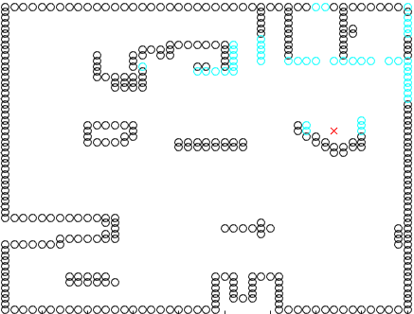
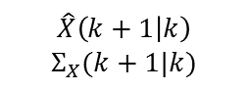
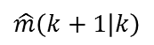
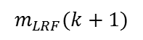
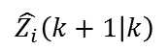
Ray casting
Use map to simulate laser scan in predicted position
Search starting angle until finding a occupied grid cell
Increase angle and repeat until reaching max angle
Return distance and angle
$$\hat{Z_{i}}\left(k+1 | k\right)$$
Observation model
$$\hat{X}\left(k+1 | k\right)$$
$$Σ_{X}(k+1|k)$$
$$\hat{m}\left(k+1 | k\right)$$
Ray casting
ICP
$$m_{LRF}(k+1)$$
Map
LRF
Notes:
Use map to simulate laser scan in predicted position

Slide 10
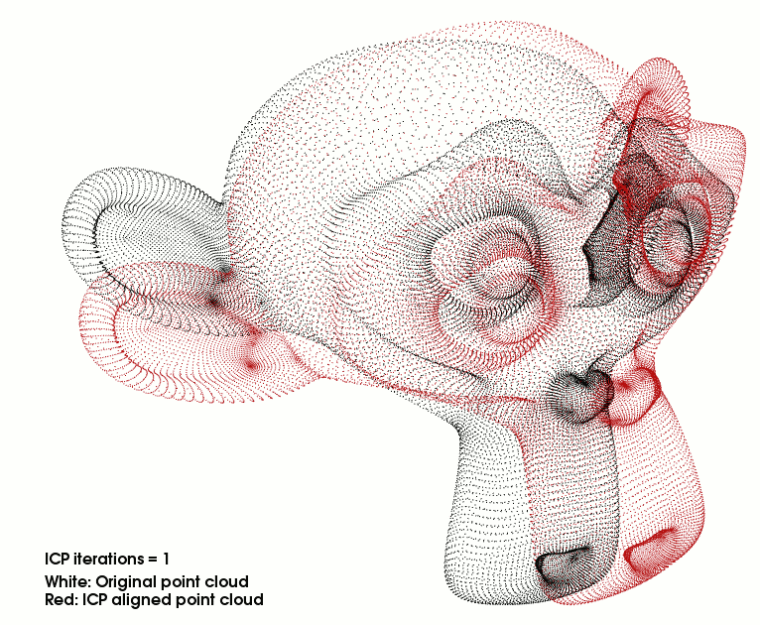
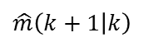
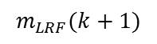

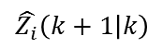
Iterative Closest Point Algorithm
Algorithm to minimize the difference between two point clouds
ICP transforms ray casting point cloud into the LRF one
Finds a transformation matrix to match the point clouds
$$\hat{Z_{i}}\left(k+1 | k\right)$$
Observation model
$$\hat{m}\left(k+1 | k\right)$$
Ray casting
ICP
$$m_{LRF}(k+1)$$
Map
LRF
Notes:
Use map to simulate laser scan in predicted position

Slide 11
Iterative Closest Point Algorithm
ICP is a black box
Empirical values for a lot of parameters within ICP
One wrong ICP result can cause heavy problems
$$\hat{Z_{i}}\left(k+1 | k\right)$$
Observation model
$$\hat{m}\left(k+1 | k\right)$$
Ray casting
ICP
$$m_{LRF}(k+1)$$
Map
LRF
Notes:
Use map to simulate laser scan in predicted position

Slide 12
EKF Implementation
Update
Matching
$$\hat{X}\left(k | k\right)$$
$$Σ_{X}(k|k)$$
$$\hat{Z_{i}}\left(k+1 | k\right)$$
Prediction
Motion model
Observation model
$$\hat{X}\left(k+1 | k\right)$$
$$Σ_{X}(k+1|k)$$
$$\hat{m}\left(k+1 | k\right)$$
Ray casting
ICP
$$m_{LRF}(k+1)$$
Odometry
Map
LRF
Notes:
Yet to be written

Slide 13
Matching
To prevent wrong updates
Either …
ICP does not converge
ICP does not match enough points
(Hard code against jumping)
Notes:
Use map to simulate laser scan in predicted position

Slide 14
EKF Implementation
Update
Matching
$$\hat{X}\left(k | k\right)$$
$$Σ_{X}(k|k)$$
$$\hat{Z_{i}}\left(k+1 | k\right)$$
Prediction
Motion model
Observation model
$$\hat{X}\left(k+1 | k\right)$$
$$Σ_{X}(k+1|k)$$
$$\hat{m}\left(k+1 | k\right)$$
Ray casting
ICP
$$m_{LRF}(k+1)$$
Odometry
Map
LRF
Notes:
Yet to be written

Slide 15
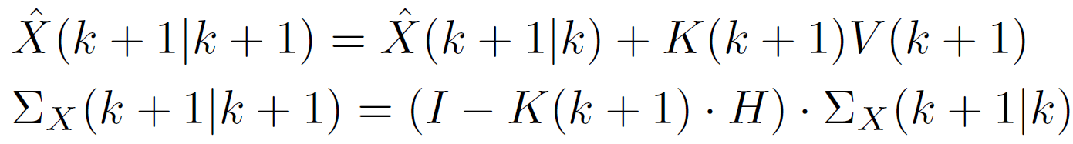
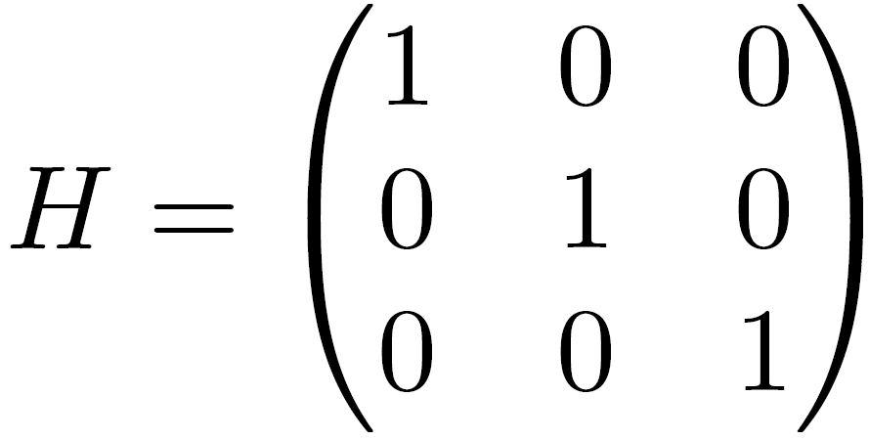
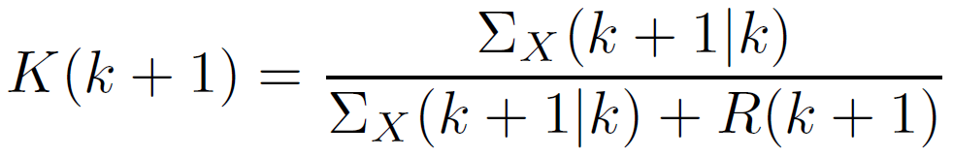
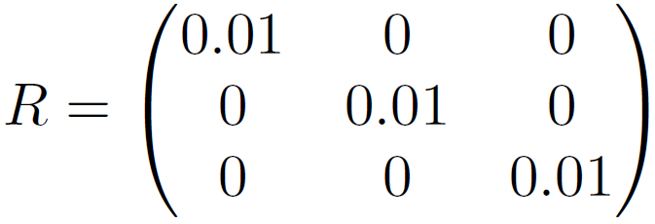
Update
Notes:
Plan to make R dependent on ICP results

Slide 16
To Do List
Finish the report until Sunday night
Work towards poster presentation
Improve measurements and create more data
Notes:
Yet to be written

Slide 17
Update
Matching
$$\hat{X}\left(k | k\right)$$
$$Σ_{X}(k|k)$$
$$\hat{Z_{i}}\left(k+1 | k\right)$$
Prediction
Motion model
Observation model
$$\hat{X}\left(k+1 | k\right)$$
$$Σ_{X}(k+1|k)$$
$$\hat{m}\left(k+1 | k\right)$$
Ray casting
ICP
$$m_{LRF}(k+1)$$
Odometry
Map
LRF

Slide 18
Project Conclusion
Notes:
Yet to be written

Slide 19
What we learned
???
Notes:
Yet to be written

Slide 20
Questions
???
Notes:
Yet to be written

